Slide 1
Smart Thread Machine
Victor Dinh

Slide 2
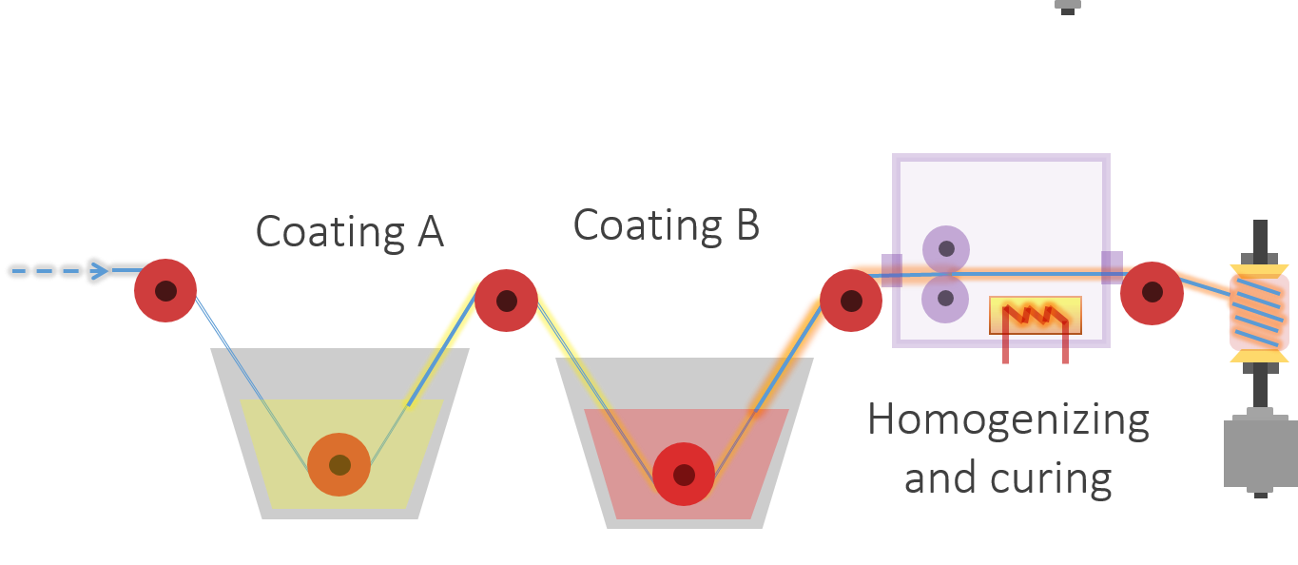
The Basic Idea
Photo creds: Hojat

Slide 3
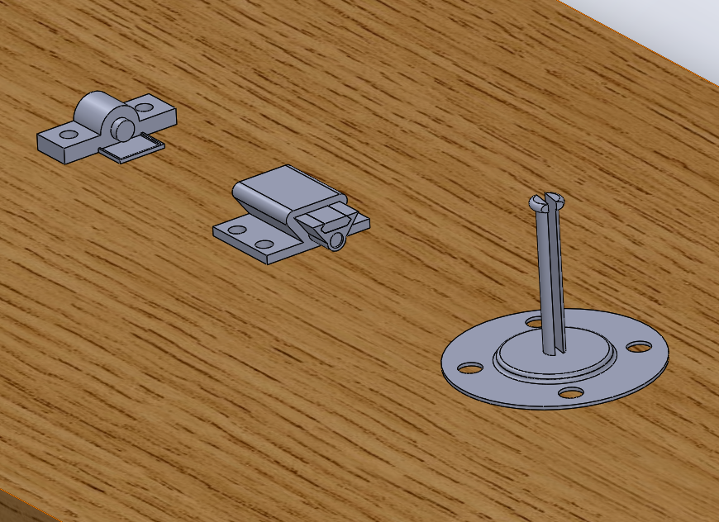
So Far…
Homogenizer
Ink cartridge
Spool holder

Slide 4
Machine components to build
Build drying mechanism
Build a winch to pull the thread through the machine

Slide 5
Next Steps
Finish setting up Raspberry Pi (display, peripherals)
Learn how to program Raspberry Pi (Python)
Interface sensors (temperature, humidity, camera sensors) with Raspberry Pi
Assemble all parts of the machine
Test and improve machine
Make an app for the machine on Raspberry Pi?

